Slide 1
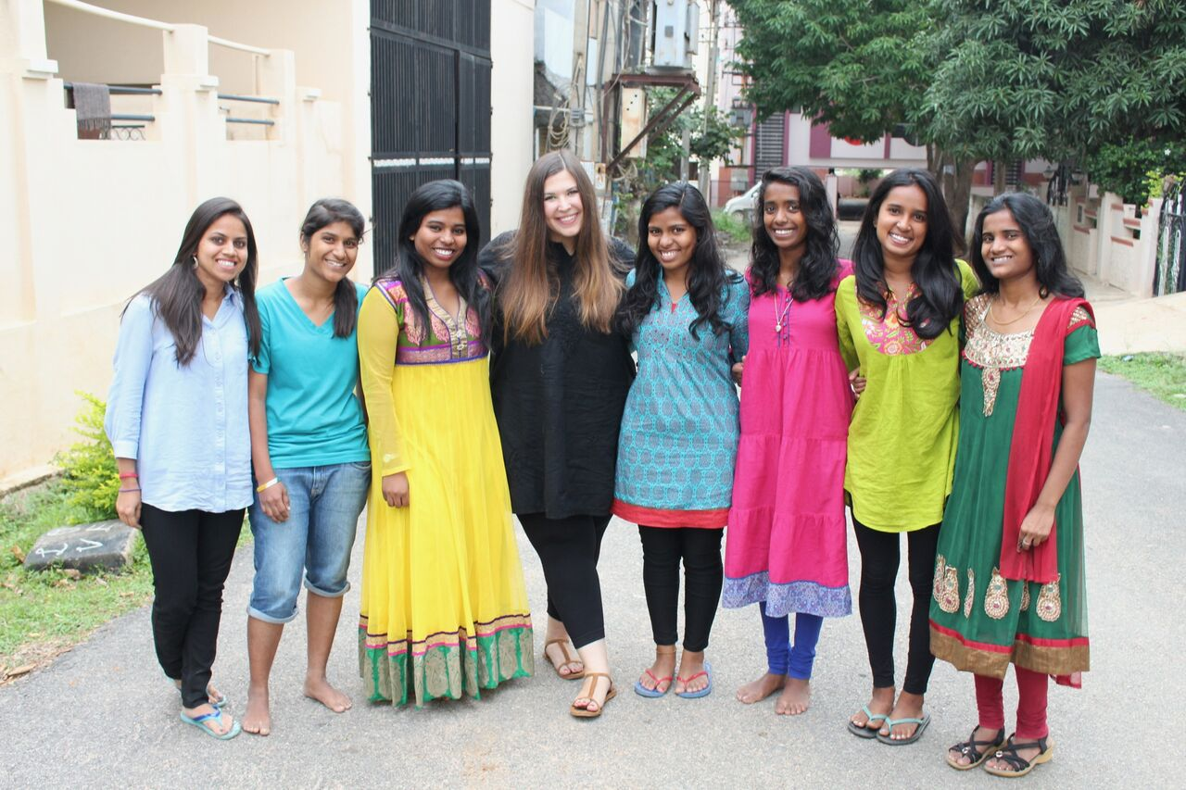
Samantha Owens & K-Ministries
Raising children:
radically committed to Jesus Christ, empowered by His Holy Spirit, spreading the Good News, transforming South Asia

Slide 2
Samantha Owens and K Ministries
Raising Children
radically committed to Jesus Christ
empowered by His Holy Spirit
spreading the Good News
transforming South Asia

Slide 4
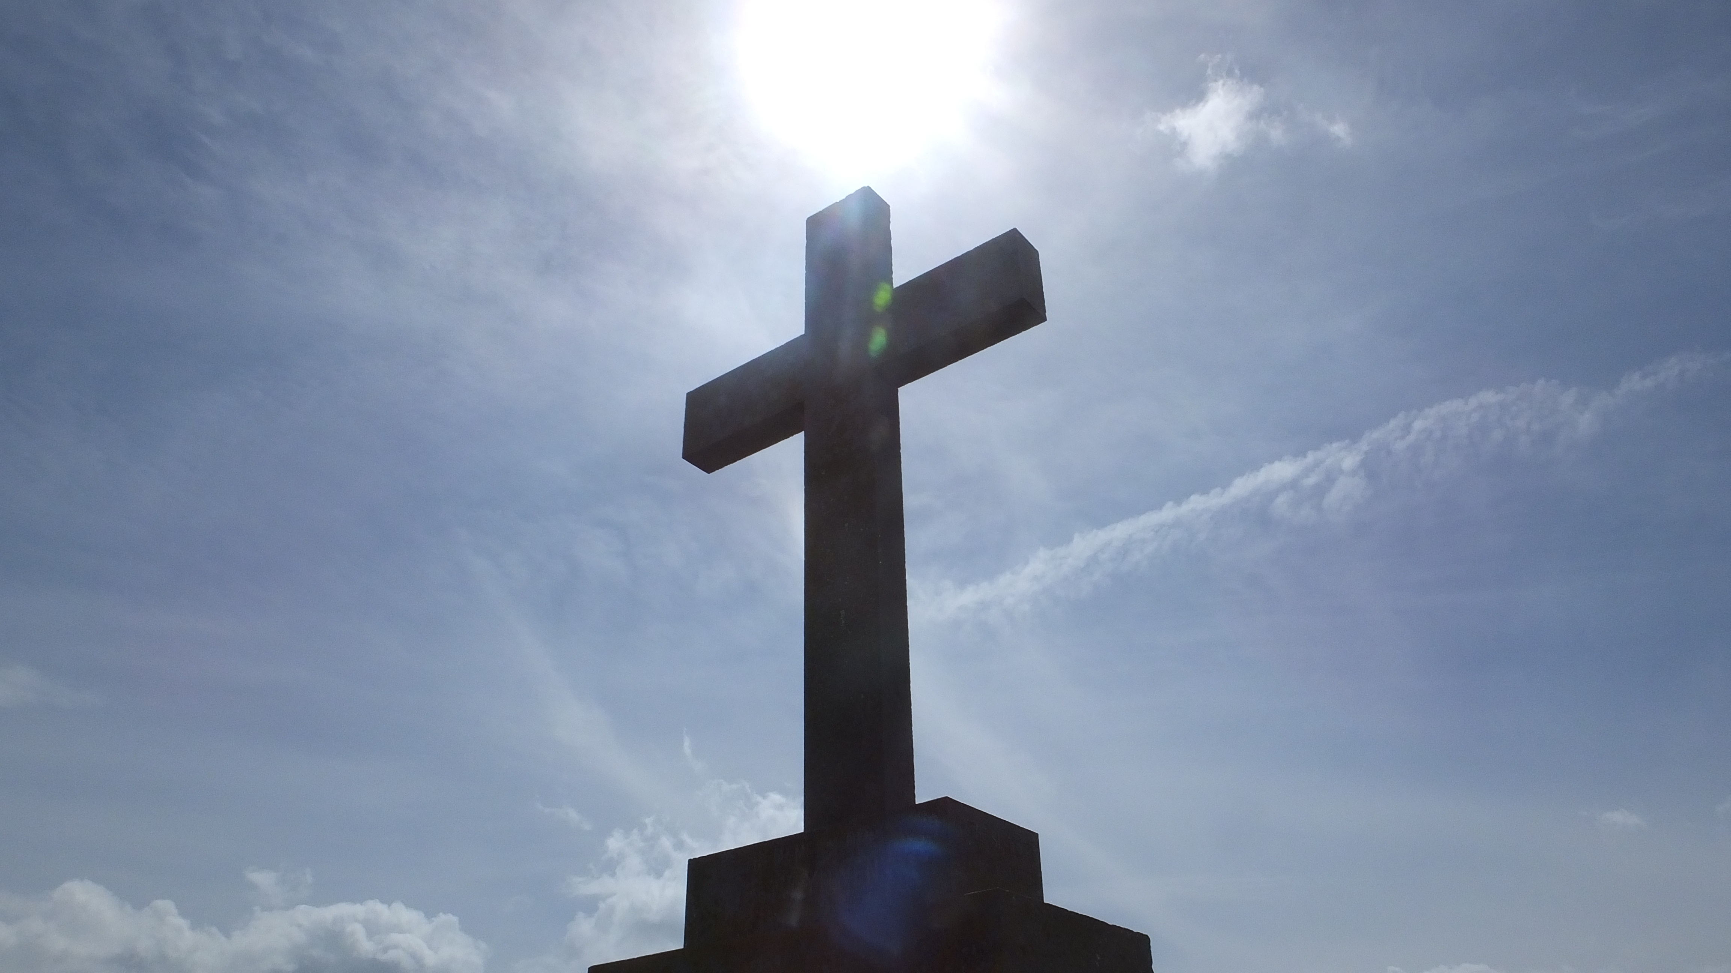
EVIDENT LIFE CHURCH
We are a People of Prayer,
Pursuing God and
Loving Others.

Slide 5
PEOPLE OF PRAYER
Sunday preservice prayer,
Wednesday Grow times praise and prayer
Ladies Soaking prayer
Men’s prayer groups
24/7 House of prayer,
Variety of subject specific prayer groups

Slide 6
Evident life church
Embracing Jesus’ Great Commission by
helping people encounter God’s presence
belong to His family and grow in His love
so that our town is transformed and our world impacted for God’s glory
Encounter ----- Belong ----- Grow

